Slide 1
4. Psychoacoustic principles
Xavier Serra

Slide 2
Index
Psychoacoustic model in perceptual coding
Auditory system
Critical bands - Bark scale
Hearing threshold
Loudness and frequency
Frequency masking
Spatial hearing
MPEG Audio bit allocation

Slide 3
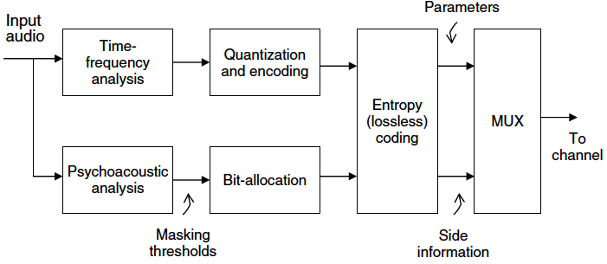
Psychoacoustic model
Loudness
Critical bands
Masking
Frequency domain
Time domain
Binaural cues

Slide 4
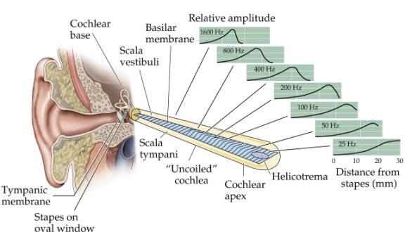
Auditory system

Slide 5
Basilar membrane as a filter bank
Bank of highly overlapping bandpass filters
The magnitude responses are asymmetric and nonlinear (level dependent)
Non-uniform bandwidth, and the bandwidths increase with increasing frequency

Slide 6
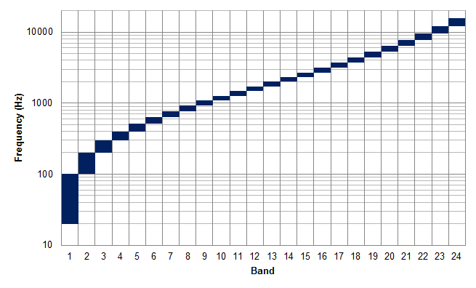
Critical Bands (Bark scale)

Slide 7
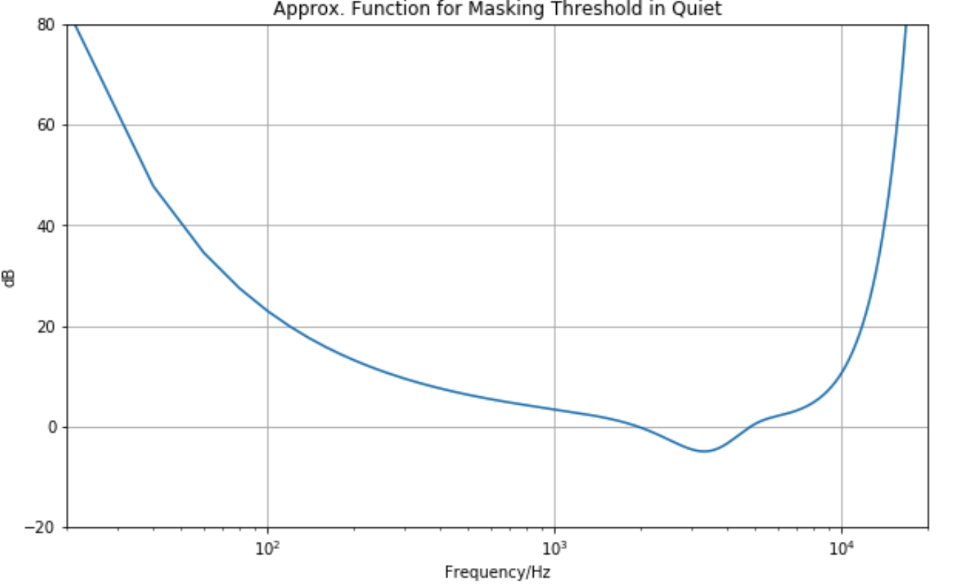
Hearing threshold

Slide 8
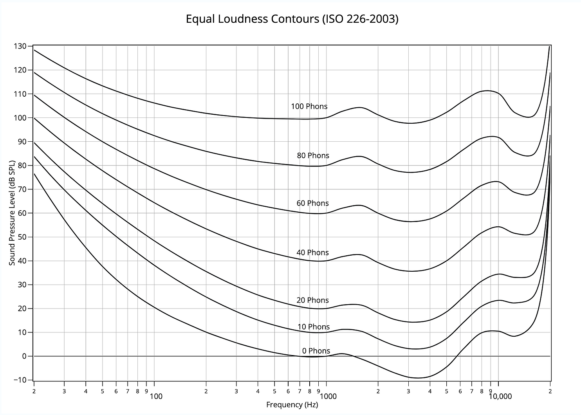
Loudness and frequency
More sensitive to loudness at mid frequencies than at other frequencies

Slide 9
Tonality
Tonality index 𝞪:
Noisy signal: 𝞪 = 0
Tonal signal: 𝞪 = 1
Sharp spectral lines -> signal is periodic -> signal is predictable
We can use prediction to approximate if a signal is tonal (by periodicity)

Slide 10
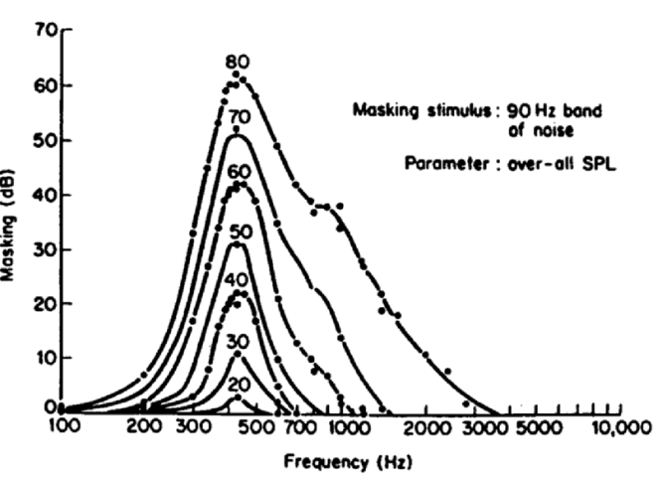
Frequency masking - spreading functions

Slide 11
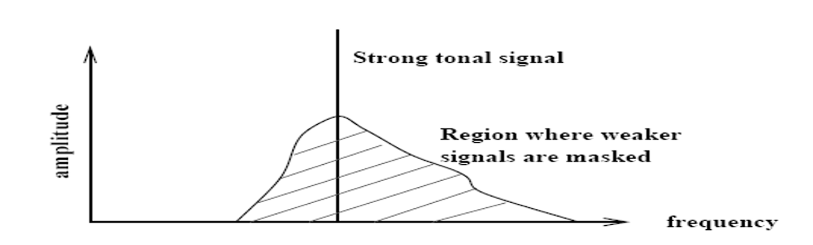
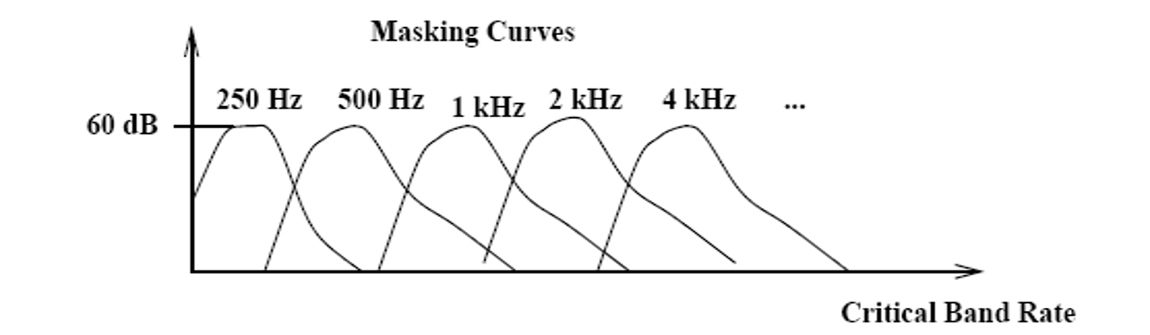
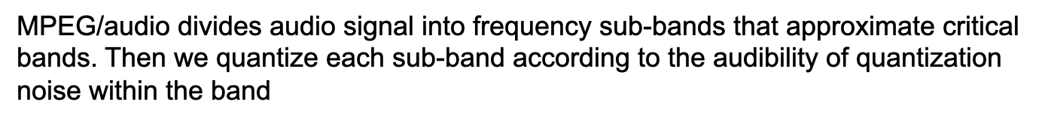

Slide 12
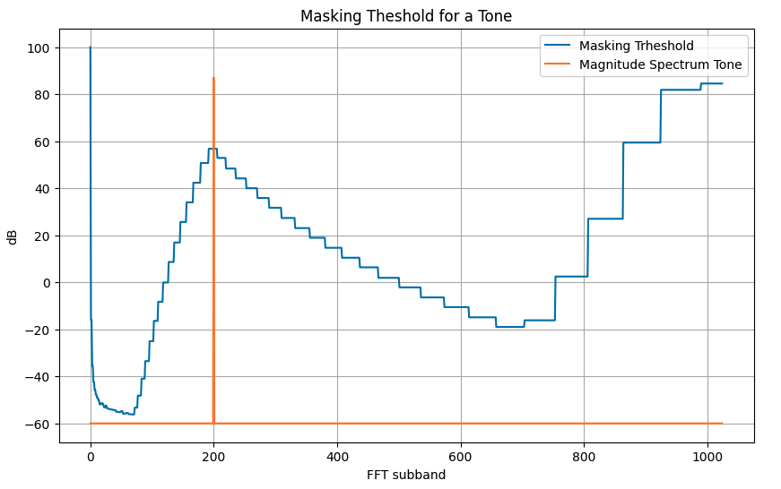

Slide 13
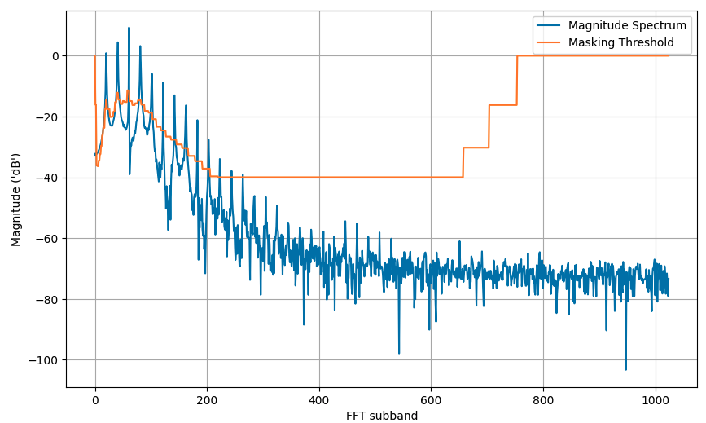

Slide 14
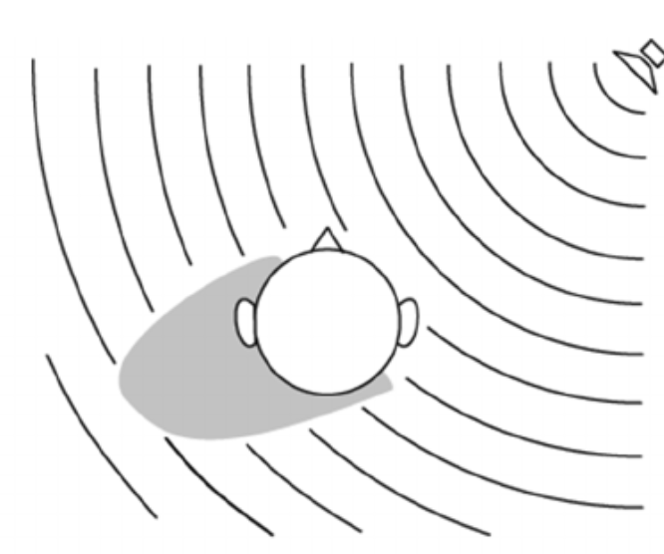
Spatial Hearing
Interaural Time Difference (ITD): Different ear arritime due to different propagation paths.
Interaural Level Difference (ILD): Different sound pressure levels due to shadowing of the head (for high frequencies)

Slide 15
Interaural Coherence (IC): degree of “similarity” between left and right signals at the ears.
Inter-Channel Coherence (ICC): degree of “similarity” between left and right channels.

Slide 16
MPEG Audio Bit Allocation
This process determines number of code bits allocated to each sub-band based on information from the psychoacoustic model
Algorithm:
Compute mask-to-noise ratio: MNR=SNR-SMR
Standard provides tables that give estimates for SNR resulting from quantizing to a given number of quantizer levels
Get MNR for each sub-band
Search for sub-band with the lowest MNR
Allocate code bits to this sub-band.
If sub-band gets allocated more code bits than appropriate, look up new estimate of SNR and repeat step 1

Slide 17
Audio Quality
Bitrate
With too low bit rate, we get compression artifacts
Ringing
Pre-echo – sound is heard before it occurs. It is most noticeable in impulsive sounds from percussion instruments such as cymbals
Occurs in transform-based audio compression algorithms
Quality of encoder and encoding parameters
Constant Bit rate encoding
Variable Bit rate encoding

